Slide 1
Incident Impact Prediction

Slide 2
Business Problem :
To predict the impact of the incident raised by the customer.
OBJECTIVE :
The objective of the analysis is to predict an impact on the basis of tickets raised.

Slide 3
EXPLORATORY Data Analysis (EDA)

Slide 4
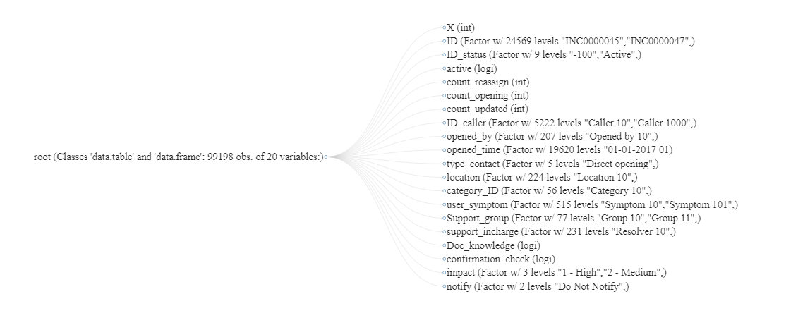
Data set details

Slide 5
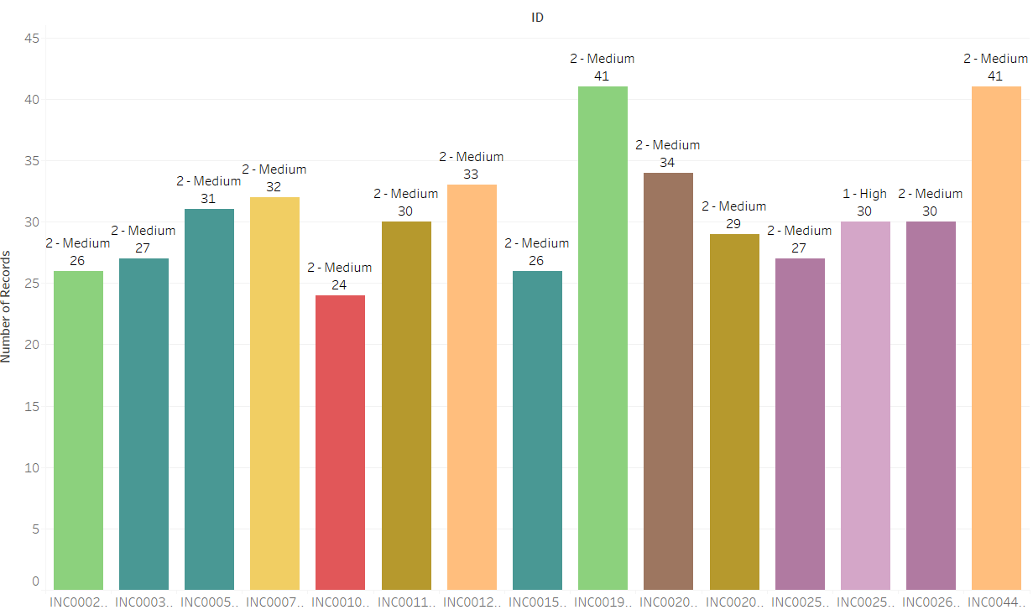
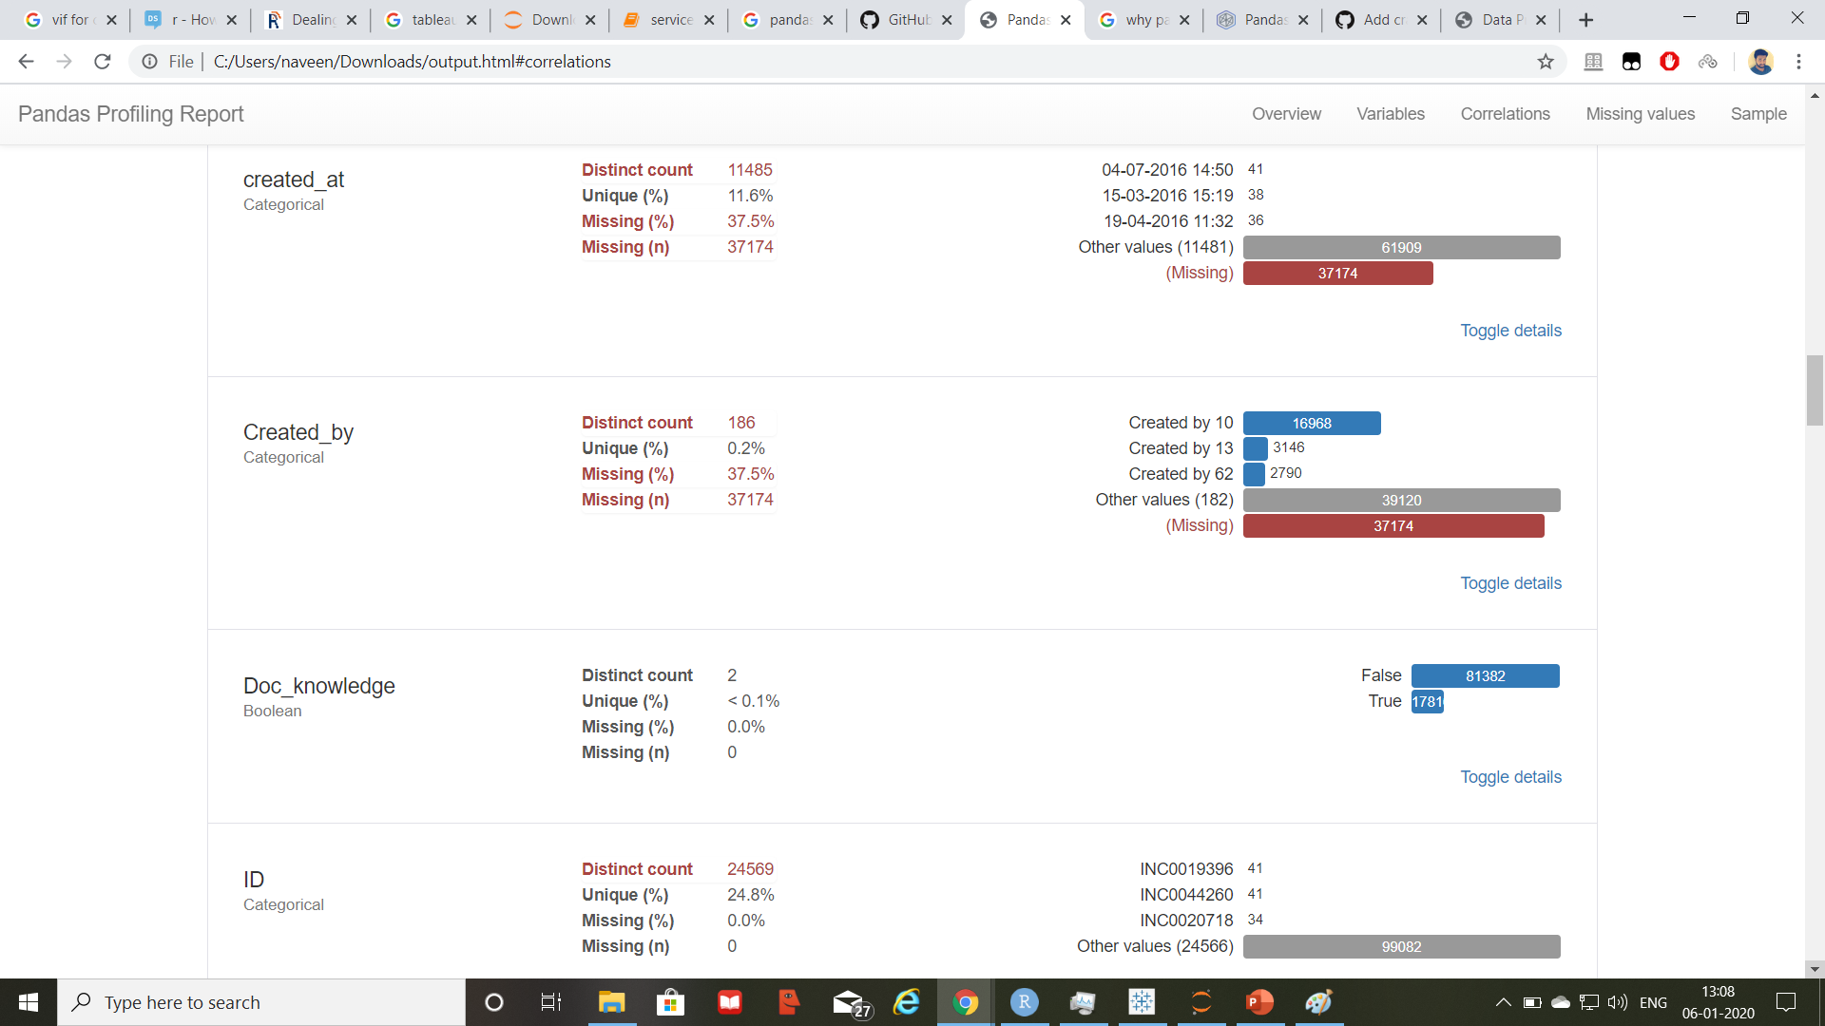
Impact on ID
Top 10 ID’s which occurred maximum time.

Slide 6
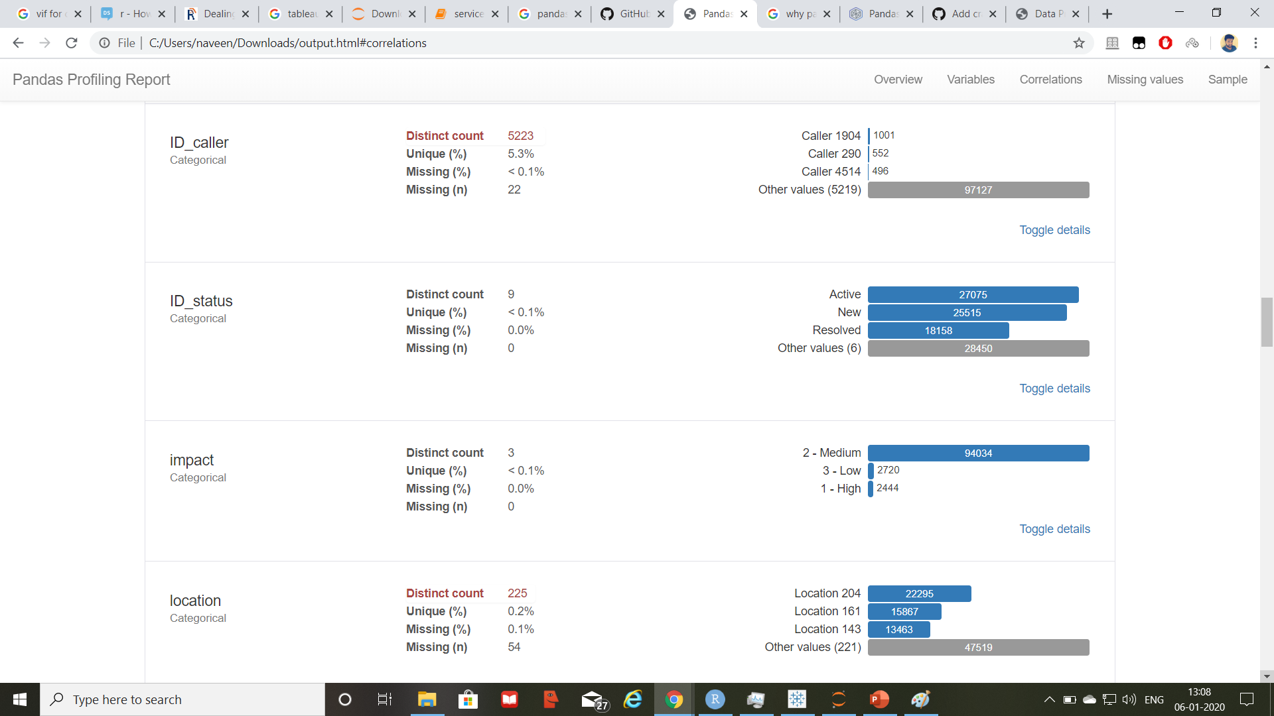
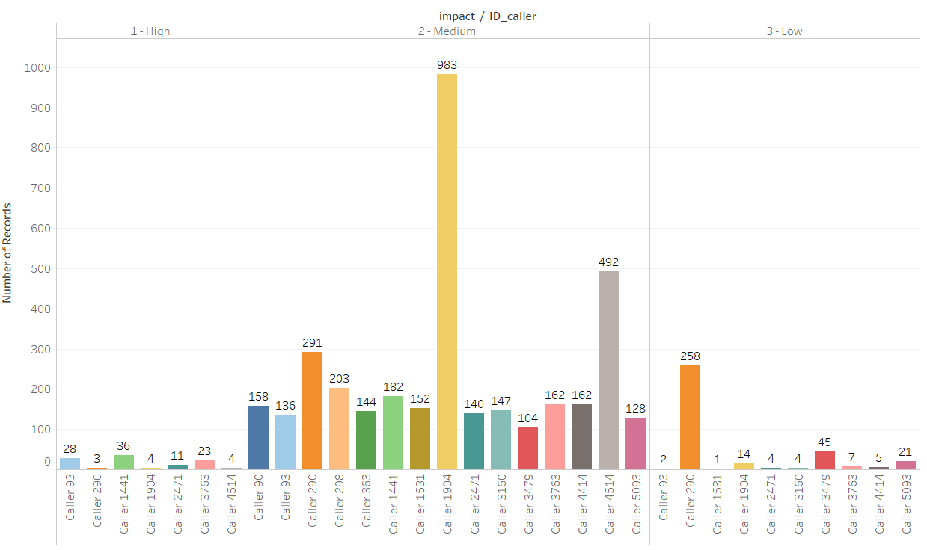
Impact on ID_caller
Incidents registered by caller having
caller_ID of 1904 is having highest no of
incidents as compared to the other
callers.

Slide 7
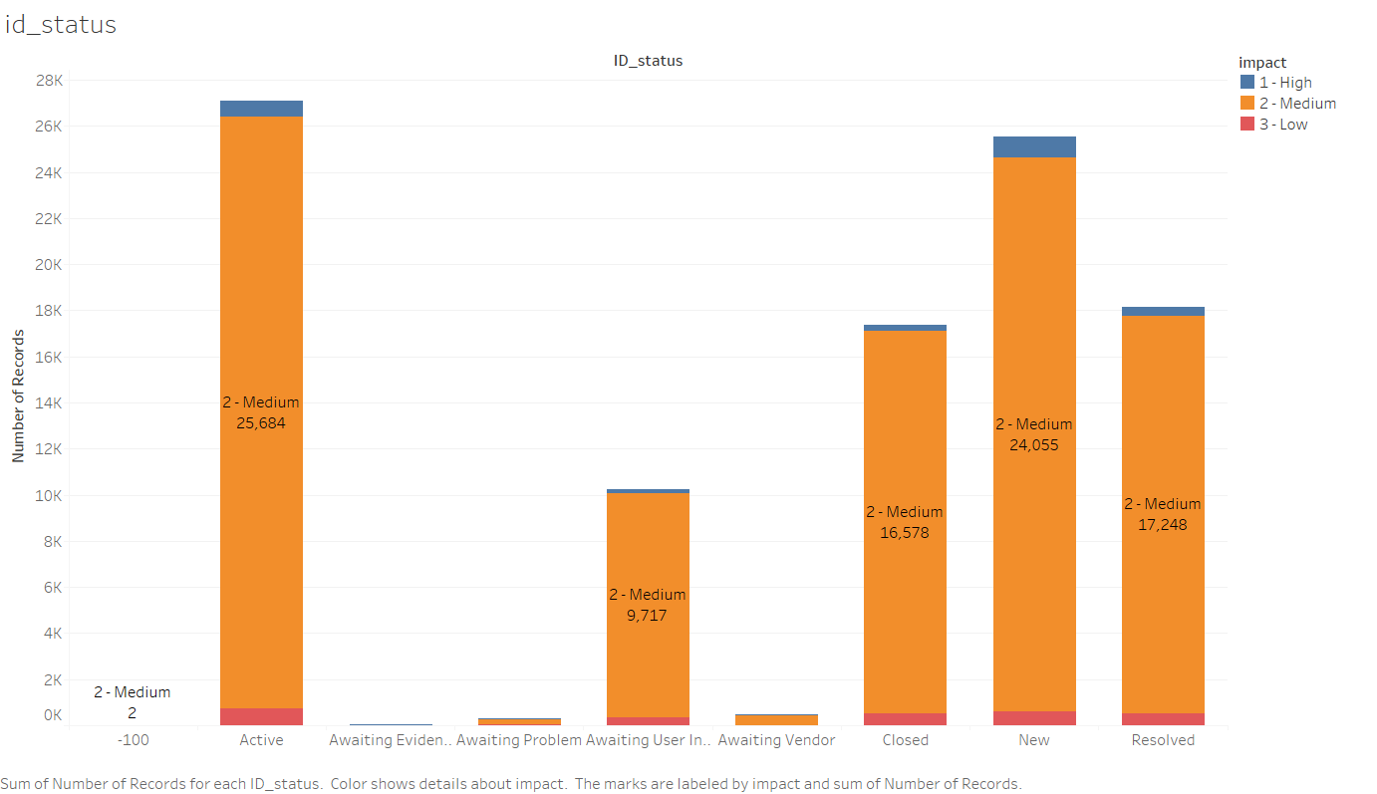
Impact on ID_status
Active status is having highest medium
impact.

Slide 8
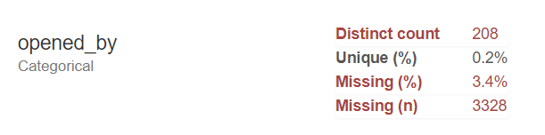
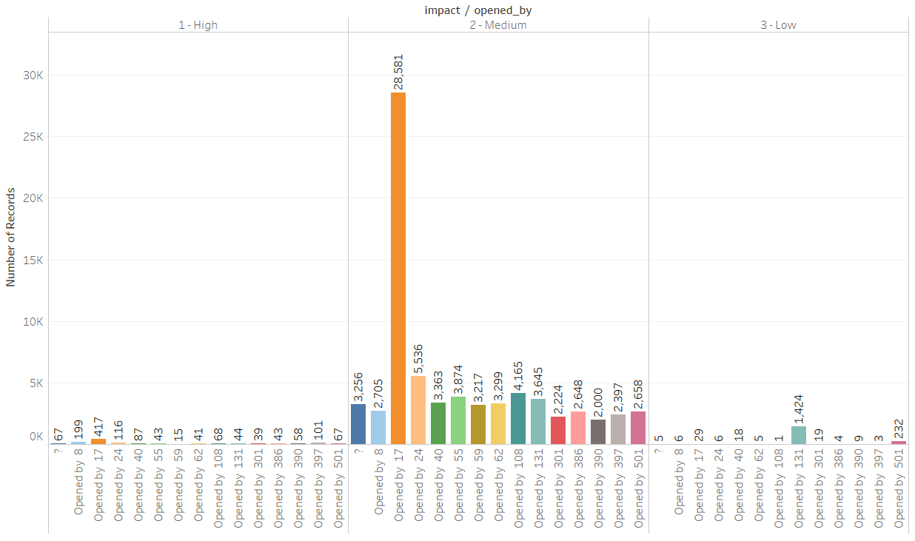
Impact on Opened_by
Incidents registered by Group 17 are highest
in total and also maximum in which has either
medium or high impact.
Group 17 opened maximum number of cases
Of location 204.

Slide 9
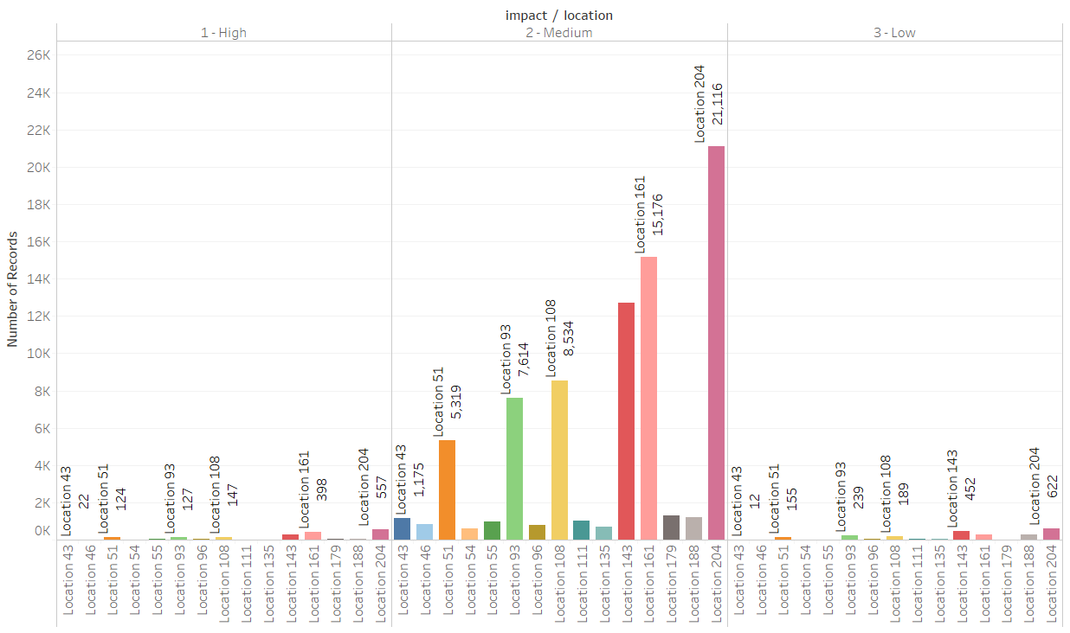
Impact on Location
In all incidents, location 204 faced highest number of cases and those cases are being opened by group 17.

Slide 10
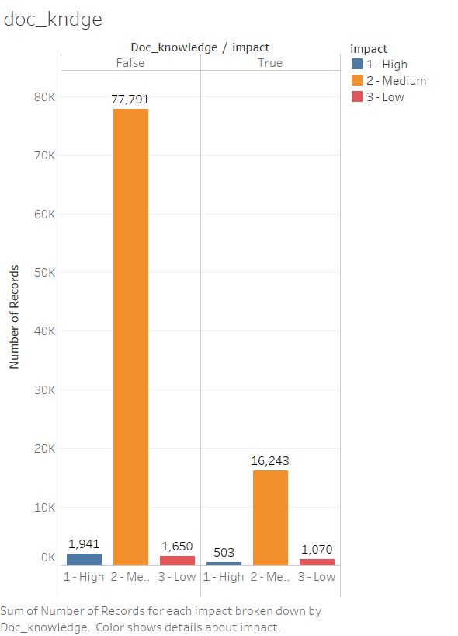
Impact on Doc_knowledge
Proportion of high impact while working according to document is 0.028
Proportion of high impact while not working according to document is 0.023

Slide 11
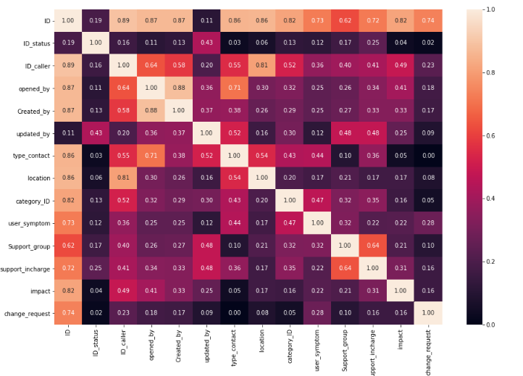
CATEGORICAL CORRELATION MATRIX(HEATMAP)
Cramer’s Value
>0.25 Very Strong
>0.15 Strong
>0.10 Moderate
>0.05 Weak
>0 No or Very Weak

Slide 12
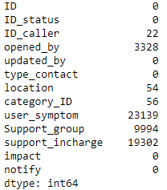
KNN Imputation
Encoding Used : Label Encoding
Independent Variables with less proportion of missing values are dropped such as ID_caller, Location, and Category_ID.
KNN imputation applied on the rest of the variables based on number of missing values. Less number of missing values are imputed first and so on.

Slide 13
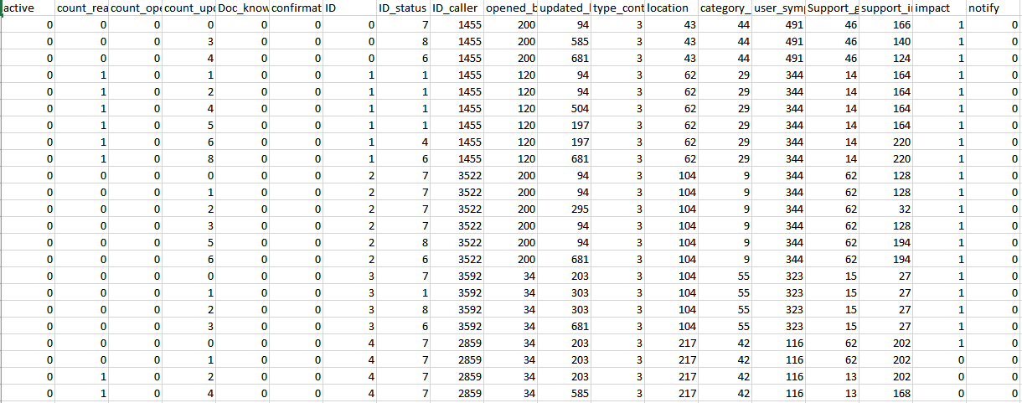
Imputated Data

Slide 14
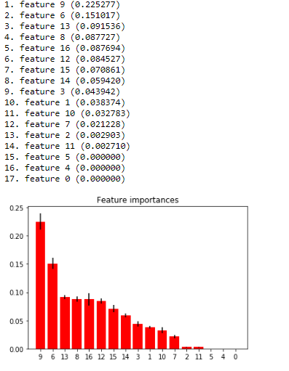
Features for consideration
Algorithm Used: ExtraTreeClassifier
Feature 9: Opened by
Feature 6: ID
Feature 13 : Category_ID
Feature 8: ID_caller
Feature 16: Support_incharge
Feature 12: Location
Feature 15: Support group
Feature 14:User_Symp
Feature 3: Count updated
Feature 1:Count_reassignment
Feature 10: Updated_by
Feature 7: ID_Check
Apart from this, we are also considering taking difference of timing and Doc Knowledge

Slide 15
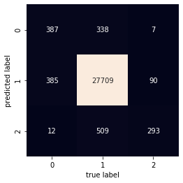
Using K Nearest Neighbors
Key Points:
Accuracy:95.40%
47% of the times low and medium incidents were considered as High(Precision).
Only 36% of the times low impact incident is considered as low otherwise 74% of time high or medium incident are predicted a low.
51% of high impact incident cases were wrongly predicted as low or medium impact incidents.
25% of the times low is wrongly predicted as high or medium impact incident.
Confusion matrix for Test Data
On Testing Data
 | Precision | Recall | F1 Score | Support
High | .53 | .49 | .51 | 784
Medium | .98 | .97 | .98 | 28556
Low | .36 | .75 | .49 | 390

Slide 16
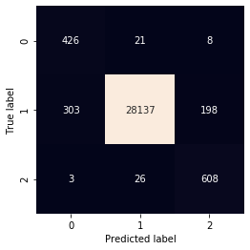
Using Random Forest Classifier
Accuracy:98.11%
42% of the times low and medium incidents were considered as High(Precision).(303+2)
Only 75% of the times low impact incident is considered as low otherwise 25% of time high or medium incident are predicted a low.(198+3)
6% of high impact incident cases were wrongly predicted as low or medium impact incidents.(21+8)
5% of the times low is wrongly predicted as high or medium impact incident.(3+26)
Confusion matrix for test data
Results on Test data
 | Precision | Recall | F1 Score | Support
High | .58 | .94 | .72 | 455
Medium | 1.00 | .98 | .99 | 28638
Low | .75 | .95 | .84 | 637

Slide 17
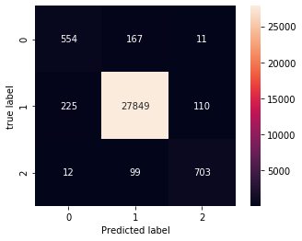
Using Decision Tree
Accuracy:97.90
30% of the times low and medium incidents were considered as High(Precision).(225+12)
Only 85% of the times low impact incident is considered as low otherwise 15% of time high or medium incident are predicted a low.(110+11)
24% of high impact incident cases were wrongly predicted as low or medium impact incidents.(167+11)
14% of the times low is wrongly predicted as high or medium impact
incident.(99+12)
Confusion matrix for Test data
On Testing Data
 | Precision | Recall | F1 Score | Support
High | .70 | .76 | .73 | 732
Medium | .99 | .99 | .99 | 28184
Low | .85 | .86 | .86 | 814

Slide 18
Under sampling using Clustering centroid
Random Forest: accuracy:0.06%
Dataset size:1700 with equal number of rows for each incident impact.
Applied under sampling on training data(70k)
 | Precision | Recall | F1 Score
High | 0.97 | 0.01 | 0.02
Medium | 0.03 | 0.97 | 0.06
Low | 0.11 | 0.95 | 0.20

Slide 19
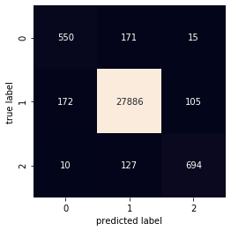
Ensemble Model using KNN, Decision Tree and Random Forest
Dataset Used : After applying combination of under sampling and oversampling(Smote Tomek)
Accuracy on 30% train data:97.98 Submission Score:97.208
25% of the times low and medium incidents were considered as High(Precision).(172+10)
Only 85% of the times low impact incident is considered as low otherwise 15% of time high or medium incident are predicted a low.(105+15)
25% of high impact incident cases were wrongly predicted as low or medium impact incidents.(171+15)
16% of the times low is wrongly predicted as high or medium impact incident.(127+10).
 | Precision | Recall | F1 Score | Support
High | .75 | .75 | .75 | 732
Medium | .99 | .99 | .99 | 28184
Low | .85 | .84 | .84 | 814

Slide 20

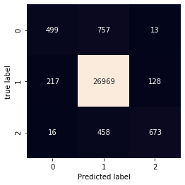
Under oversampling using Smote Tomek
Applied this algorithm on training dataset on 70% of training data.
Size of Low and high increased to 65k and number of observation from medium incident were reduced to 65k.
Random forest Accuracy:97.97
Decision Tree Accuracy:95
 | Precision | Recall | F1 Score | Support
High | .67 | .78 | .72 | 623
Medium | .99 | .99 | .99 | 28325
Low | .81 | .85 | .83 | 782
 | Precision | Recall | F1 Score | Support
High | .68 | .39 | .50 | 1269
Medium | .96 | .99 | .97 | 27314
Low | .83 | .59 | .69 | 1147

Slide 21
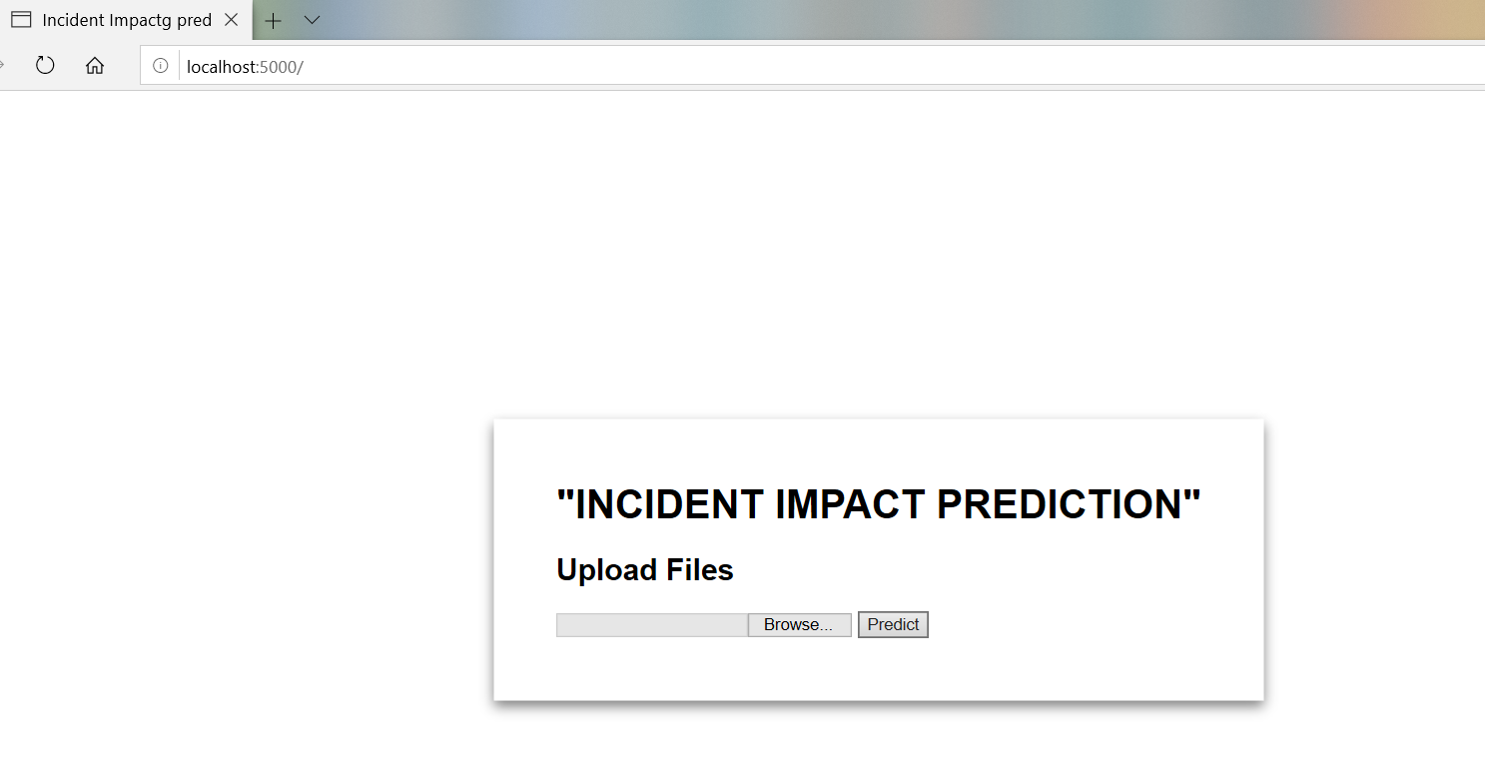
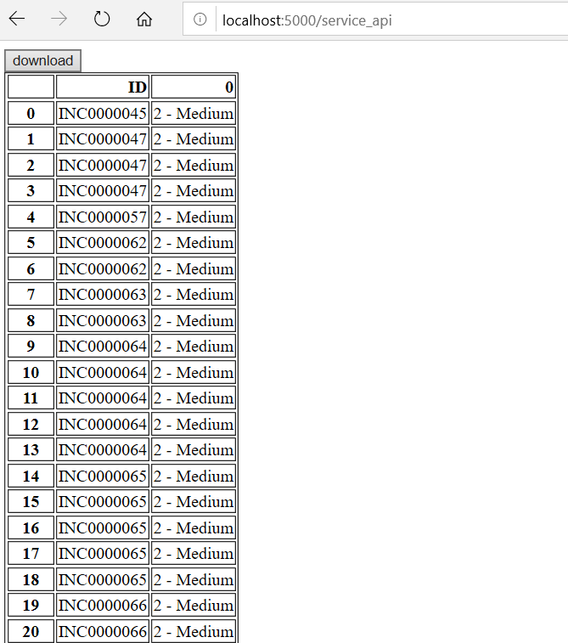
Deployment using Flask

Slide 22
Brief Overview
Step 1: Research work to get acquainted with ServiceNow software and its operational working
Step 2: EDA Phase using univariate, bivariate analysis using pandas, seaborn and matplotlib. For multivariate analysis are being done in Tableau.
Step 3: Feature selection using EDA and extra tree classifier technique.
Step 4: Missing values are dealt using classification algorithms(KNN, RF)
Step 5: Implemented various classification on training sets with 70:30 partitioning.
Step 6: Applied grid search with cross validation technique to train model better and get best parameters.
Step 7: In order to cover all aspects of different algorithms as well as to improve recall, precision for three categories of target variables, ensemble method is applied using KNN, Decision Tree and random forest.
Step 8:Balanced the dataset using Smote Tomek and followed the above steps to get balanced results.
Step 9: Deployed final model using flask, where concerned person can upload file and view results in html and can download as well.

Slide 23
Challenges faced
Data pre-processing took much of the time as there were large set of missing values in different categories.
Choosing encoding techniques as there were large number unique values for categorical variables.
Faced difficulty while uploading and downloading the test file during deployment time.

